Slide 3
God’s Will, Not My Own
James 1
Gaining from Trials
“Count it all joy..” (Count it nothing but joy)
When focusing on the negative= Valuable lesson is lost!
“Count it all joy when you fall..”
(Peripiptein)- Luke 10:30 – “A certain man went down from Jerusalem to Jericho, and fell among thieves..”
Meaning= to encounter or to fall among
“Count it all joy when you fall into various trials..”
Rom. 5:1-5 & 1 Pet. 1:6-7
Trials will come, find joy in Christ!

Slide 4
God’s Will, Not My Own
James 1
Gaining from Trials
Pray! (verse 6 & 5:13-16)
James 5:16- “The effective, fervent prayer of a righteous man avails much.”
Social Status Does Not Matter
Lowly & Rich Brothers = Glorify God
God is Not Against You in Your Trials
Survey from 2010- 2/3 of Americans blamed God for some type of suffering
God Does Not Wish That Any Should Perish! (2 Pet. 3:9)

Slide 5
God’s Will, Not My Own
James 1
Gaining from Trials
Self Control
“Most people do not listen with the intent to understand; they listen with the intent to reply.”
Think of James’ audience - Jews (Acts 13:16; 44-45)
The Ability to Listen Shows Great Self Control

Slide 6
God’s Will, Not My Own
James 1
Gaining from Trials
Self Control
Being an Active Hearer

Slide 7
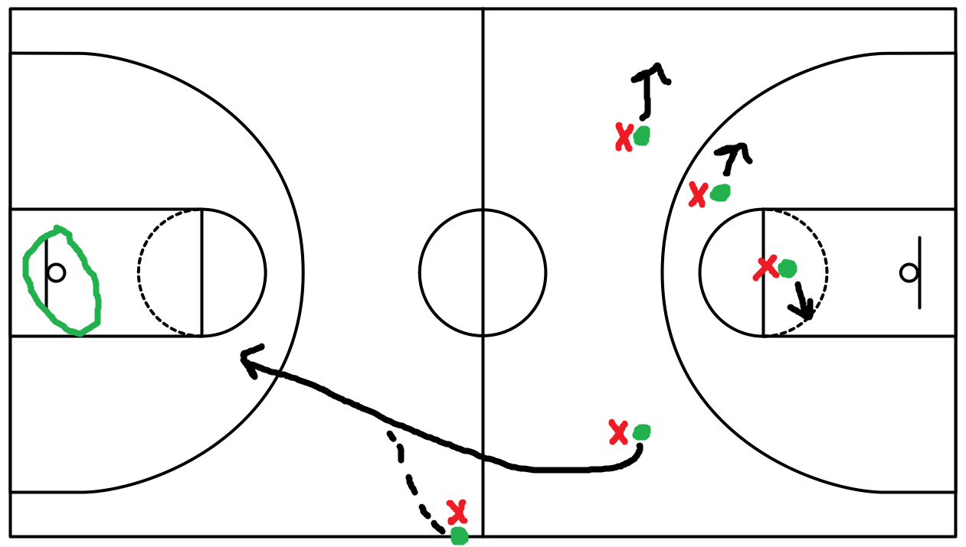

Slide 8
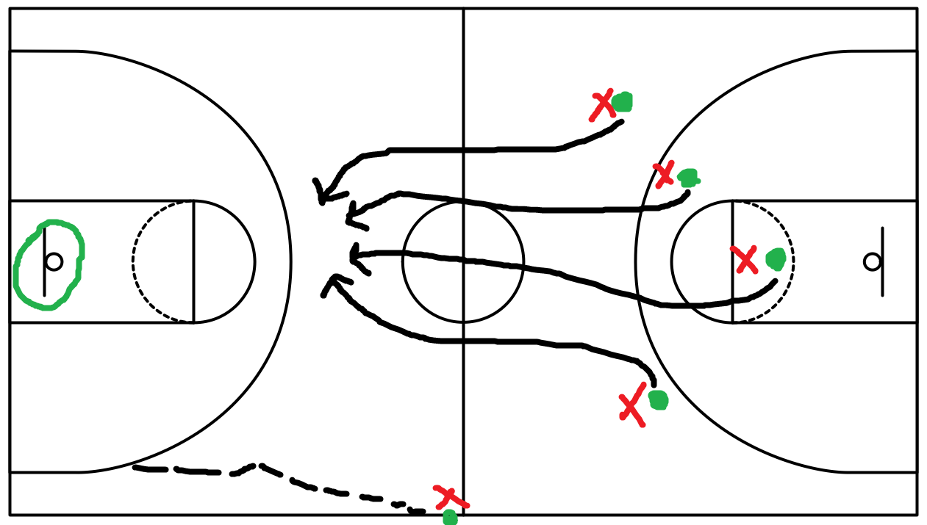

Slide 9
God’s Will, Not My Own
James 1
Gaining from Trials
Self Control
Being an Active Hearer
Hearing Only Goes So Far…
Looking into a Mirror
Do We Allow God’s Word To Help Us Make Corrections In Our Lives?
James 2:26 – “For as the body without the spirit is dead, so faith without works is dead also.”

Slide 10
God’s Will, Not My Own
As We Are Striving To Follow God’s Will, Remember:
This World is Going to be Filled with Trials – Find Joy!
No Matter Your Social Status – Glorify God!
Whether those around us agree or not – Work Hard!

