Slide 2
“The terms of the President and Vice President shall end at noon on the 20th day of January, and the terms of Senators and Representatives at noon on the 3d day of January, of the years in which such terms would have ended if this article had not been ratified; and the terms of their successors shall then begin.”

Slide 3
LOST IN THE CREDITS
JOSIAH
2 KINGS 22-23; 2 CHR 34-35
EXTRAORDINARY LESSONS FROM
ORDINARY PEOPLE

Slide 4
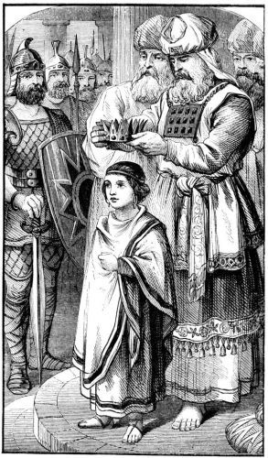
JOSIAH
AGE 8- CROWNED KING
AGE 16- SOUGHT GOD
AGE 20- DESTROYED IDOLATRY
AGE 26- TEMPLE REPAIRED

