Slide 2
LOST IN THE CREDITS
NEPHILIM
GEN 6; NUM 13
EXTRAORDINARY LESSONS FROM
ORDINARY PEOPLE

Slide 3
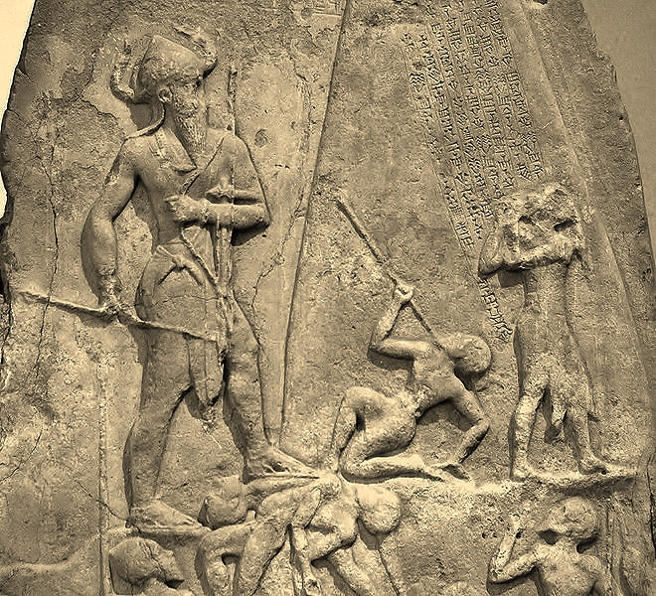
Compromise
Rulers
Intermarriage
Angels
The Antediluvian World

Slide 4
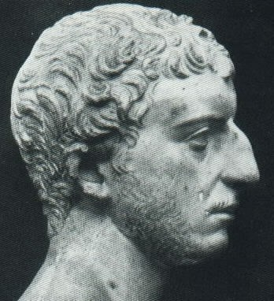
“For many angels of God accompanied with women, and begat sons that proved unjust, and despisers of all that was good, on account of the confidence they had in their own strength; for the tradition is, that these men did what resembled the acts of those whom the Grecians call giants”
(Antiquities of the Jews, 1.72-75).

Slide 5
Compromise
The Antediluvian World

Slide 6
Compromise
Corruption
Condemnation
The Antediluvian World

