Slide 2
LOST IN THE CREDITS
GIDEON
JUDGES 6-7
EXTRAORDINARY LESSONS FROM
ORDINARY PEOPLE

Slide 3
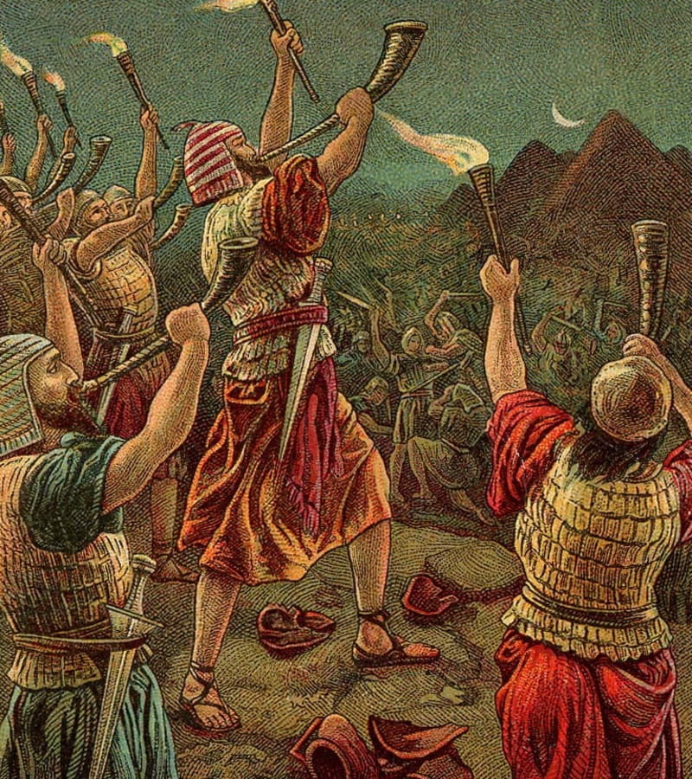
OBSTACES FACING GIDEON
Obstacles of why
Obstacles of self
Obstacles of faith

