Slide 2
LOST IN THE CREDITS
HANNAH
1 Samuel 1-2
EXTRAORDINARY LESSONS FROM
ORDINARY PEOPLE

Slide 3
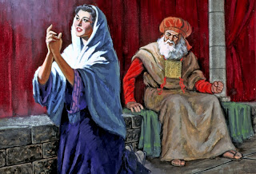
LESSONS FROM HANNAH
Godly women will endure heartaches
Godly women offer prayers
Godly women accept God’s answers
Godly women praise the Lord

