Slide 2
DOES YOUR SPEECH BETRAY…
YOUR MORAL VALUES
YOUR VALUE OF OTHERS
YOUR SPIRITUAL VALUES

Slide 3
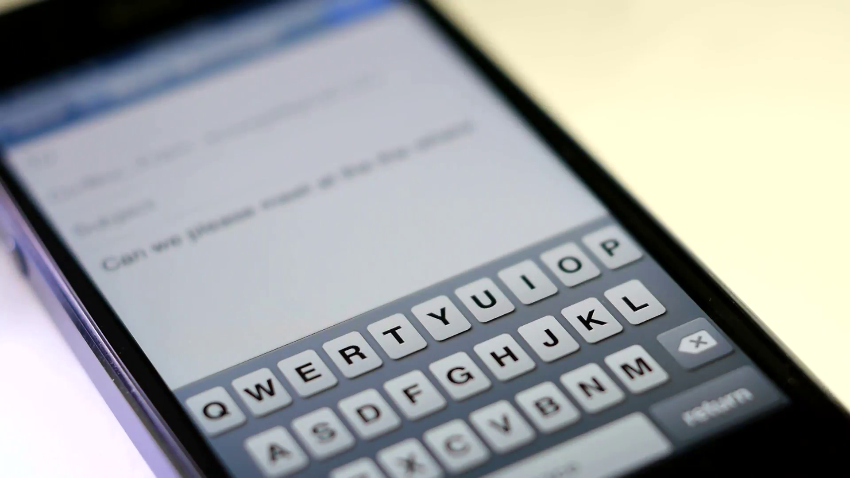
OMG

Slide 4
KINGDOM SPEECH IS…
ORACLE SPEECH
EDIFYING SPEECH
SEASONED SPEECH

