Slide 1
Made in God’s Image

Slide 2
Genesis 1:26-27
Then God said, “Let us make man in our own image, after our likeness. And let them have dominion over the fish of the sea and over the birds of the heavens and over the livestock and over all the earth and over every creeping thing that creeps on the earth.” So God created man in his own image, in the image of God he created him; male and female he created them.

Slide 3
Genesis 1:26-27
Then God said, “Let us make man in our own image, after our likeness. And let them have dominion over the fish of the sea and over the birds of the heavens and over the livestock and over all the earth and over every creeping thing that creeps on the earth.” So God created man in his own image, in the image of God he created him; male and female he created them.

Slide 4
Made in God’s Image
How are we in God’s likeness?

Slide 5


We are Creators

Slide 6
We are Creators
Psalm 8:5-9

Slide 7
We are Creators
Psalm 8:5-9
  God has given us dominion over the works of his hands.

Slide 8
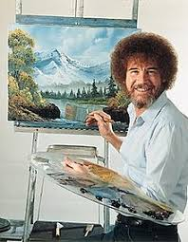
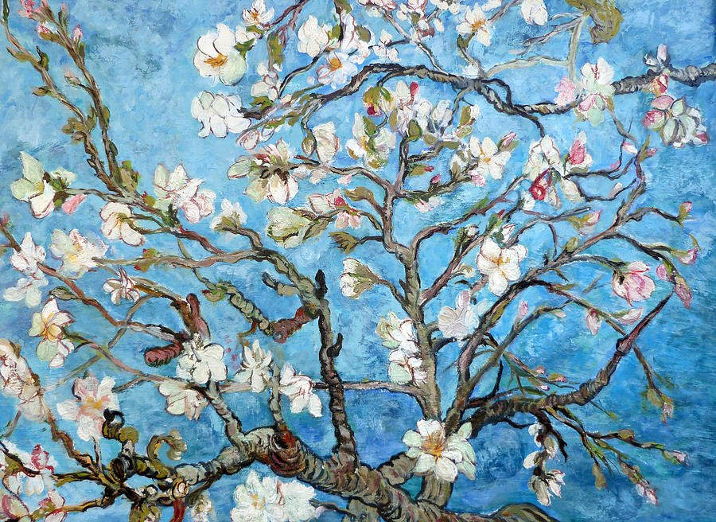
We are Artists

Slide 9
We are Artists
Exodus 31:1-6

Slide 10
We are Artists
Exodus 31:1-6
  When we exercise our ability, intelligence, knowledge, and craftsmanship we reflect the Spirit of God

Slide 11

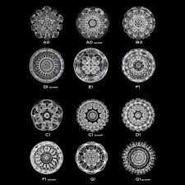
We are Musicians

Slide 12
We are Musicians
Psalm 135:3

Slide 13
We are Musicians
Psalm 135:3
  It is pleasant to God when we sing to him

Slide 14

We are Emotional

Slide 15
We are Emotional
God expresses anger
  Psalm 106:40; Isaiah 5:25
God expresses love
  John 3:16; Romans 5:8
God expresses hate
  Psalm 5:5; Psalm 11:5
God expresses compassion
  Genesis 19:16; Exodus 33:19
God expresses grief
  Genesis 6:6; Isaiah 63:10
God expresses joy
  Nehemiah 8:10; Zephaniah 3:17

Slide 16
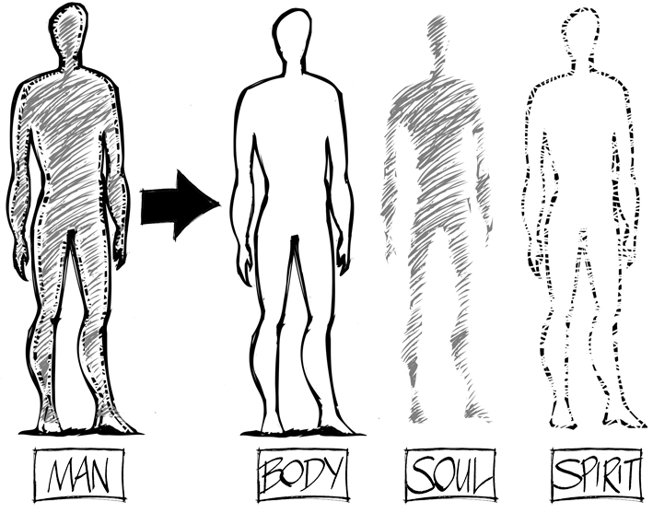
We are Eternal

Slide 17
We are Eternal
Luke 16:19-31

Slide 18
We are Eternal
Luke 16:19-31
  Whether we listen to God’s word determines whether we spend our eternity in peace or agony

Slide 19
We are Eternal
Luke 16:19-31
  Whether we listen to God’s word determines whether we spend our eternity in peace or agony

Slide 20
We are Eternal
Thank God for Jesus who washes away sin!
Hebrews 10:11-12
  And by that will we have been sanctified through the offering of the body of Jesus Christ once for all. And every priest stands daily at his service, offering repeatedly the same sacrifices, which can never take away sins. But when Christ had offered for all time a single sacrifice for sins, he sat down at the right hand of God,

