Slide 2
LOST IN THE CREDITS
RECHABITES
JEREMIAH 35
EXTRAORDINARY LESSONS FROM
ORDINARY PEOPLE

Slide 3
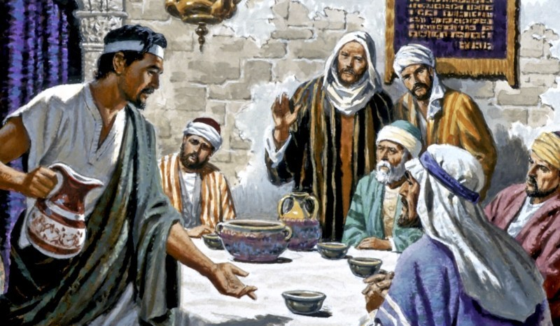
COMMITMENT
MUST BE SHARED
MAKES YOU STRANGE
WILL SAVE

