Slide 2
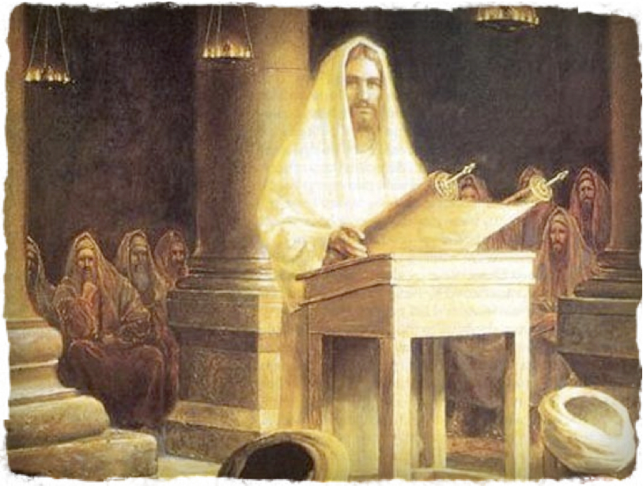
THE YEAR OF THE LORD
LUKE 4.16-30

Slide 3
THE YEAR OF THE LORD
LUKE 4.16-30
Jesus and the Bible
Gentiles and the Blessings
Nazarenes and the Backlash

