Slide 2
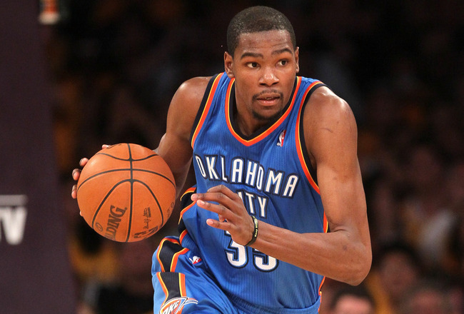
“Everyone told us we wasn’t supposed to be here… you made us believe, you kept us off the streets, you put clothes on our backs, food on the table. When you didn’t eat you made sure we ate, you went to sleep hungry, you sacrificed for us. You are the real MVP”

Slide 3
MEDICINE:
“If you don’t stop picking at that it will get infected”
GENETICS:
“You are just like your father!”
ROOTS:
“Do you think you were born in a barn?”
JUSTICE:
“One day you will have kids, and I hope they turn out just like you.”
PATIENCE:
“Just wait until your dad gets home”
RELIGION:
“You better pray that will come out of the carpet.”

Slide 5
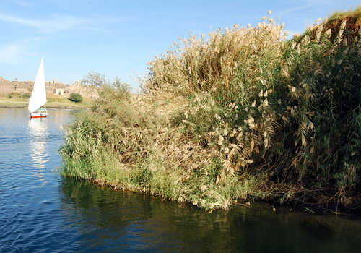
THE MOTHERS OF MOSES
LIFE
LOVE
LEGACY

Slide 6
THE MOTHERS OF MOSES
LIFE
LOVE
LEGACY

Slide 7
“My name has six letters. The first one is M. I pick up things. What am I?”
M O T H E R

