Slide 2
LOST IN THE CREDITS
BALAAM
NUMBERS 21-25, 31
EXTRAORDINARY LESSONS FROM
ORDINARY PEOPLE

Slide 3
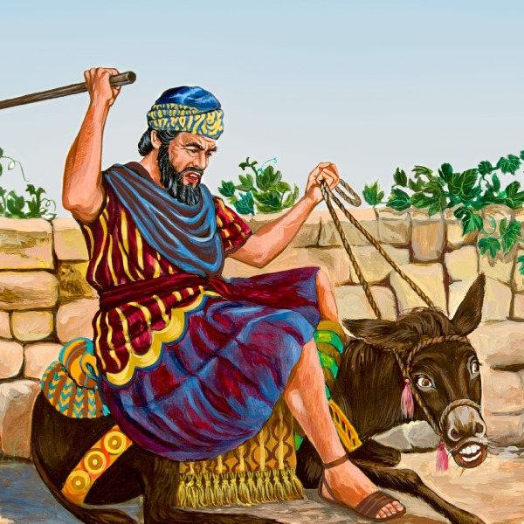
BALAAM
THE WAY OF BALAAM
THE ERROR OF BALAAM
THE DOCTRINE OF BALAAM

