Slide 2
LOST IN THE CREDITS
JABEZ
1 CHR 4
EXTRAORDINARY LESSONS FROM
ORDINARY PEOPLE

Slide 3
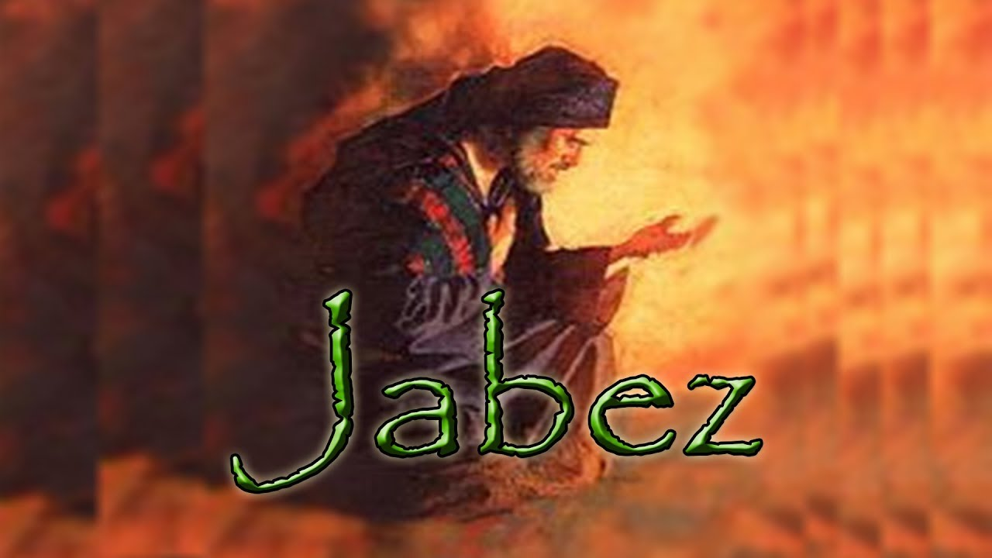
JABEZ
DISTINCT NAME
DISTINCT HONOR

Slide 4
JABEZ
Adam Clarke- “On these accounts he was more honorable than his brethren. He was of the same stock and the same lineage; he had neither nobility of birth, nor was distinguished by earthly titles; in all these respects he was on a level with his brethren: but God tells us that he was more honorable than them all; and why? because he prayed, because he served his Maker, and because he lived to do good among men; therefore he received the honor that cometh from God.”

Slide 5
JABEZ
DISTINCT NAME
DISTINCT HONOR
DISTINCT PRAYER

Slide 6
JABEZ
G. Campbell Morgan- “While through these genealogies, and indeed through all the history, we are occupied with those connected with government and the procession of events leading to universal issues, it is refreshing to be halted by the story of one man who took his need directly to God and obtained the answer of God’s grace.”

Slide 7
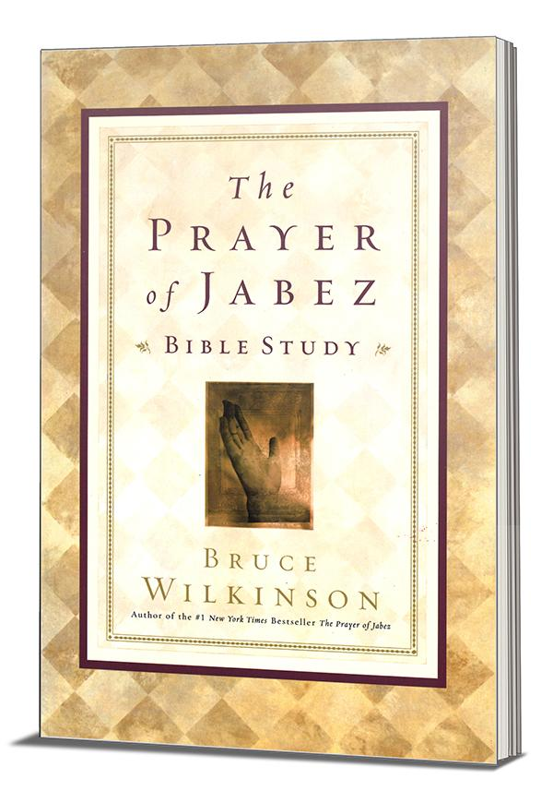

Slide 8
PRAYER OF JABEZ
He prayed for blessings
He prayed for increase
He prayed for guidance
He prayed for protection

