Slide 2
LOST IN THE CREDITS
STEPHEN
ACTS 6-7
EXTRAORDINARY LESSONS FROM
ORDINARY PEOPLE

Slide 3
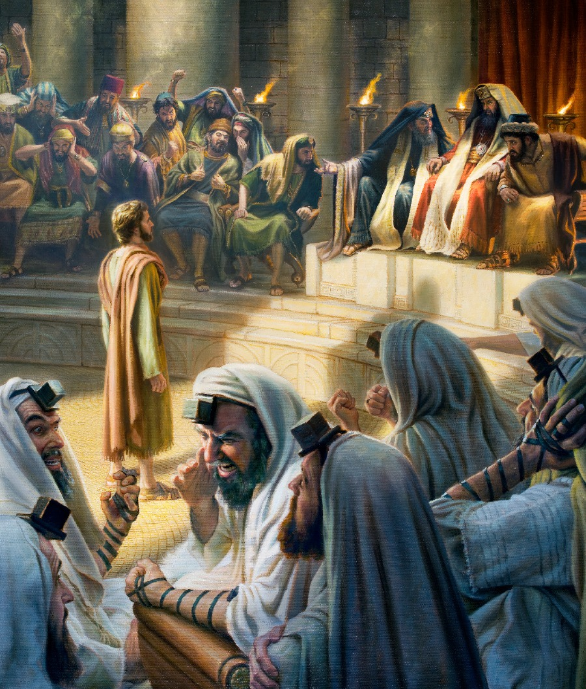
STEPHEN
FULL OF THE SPIRIT
FULL OF WISDOM
FULL OF FAITH
FULL OF POWER

Slide 4
STEPHEN’S SERMON
RESTRICKED GOD
REJECTED PROPHETS
RESISTED THE SPIRIT

