Slide 2
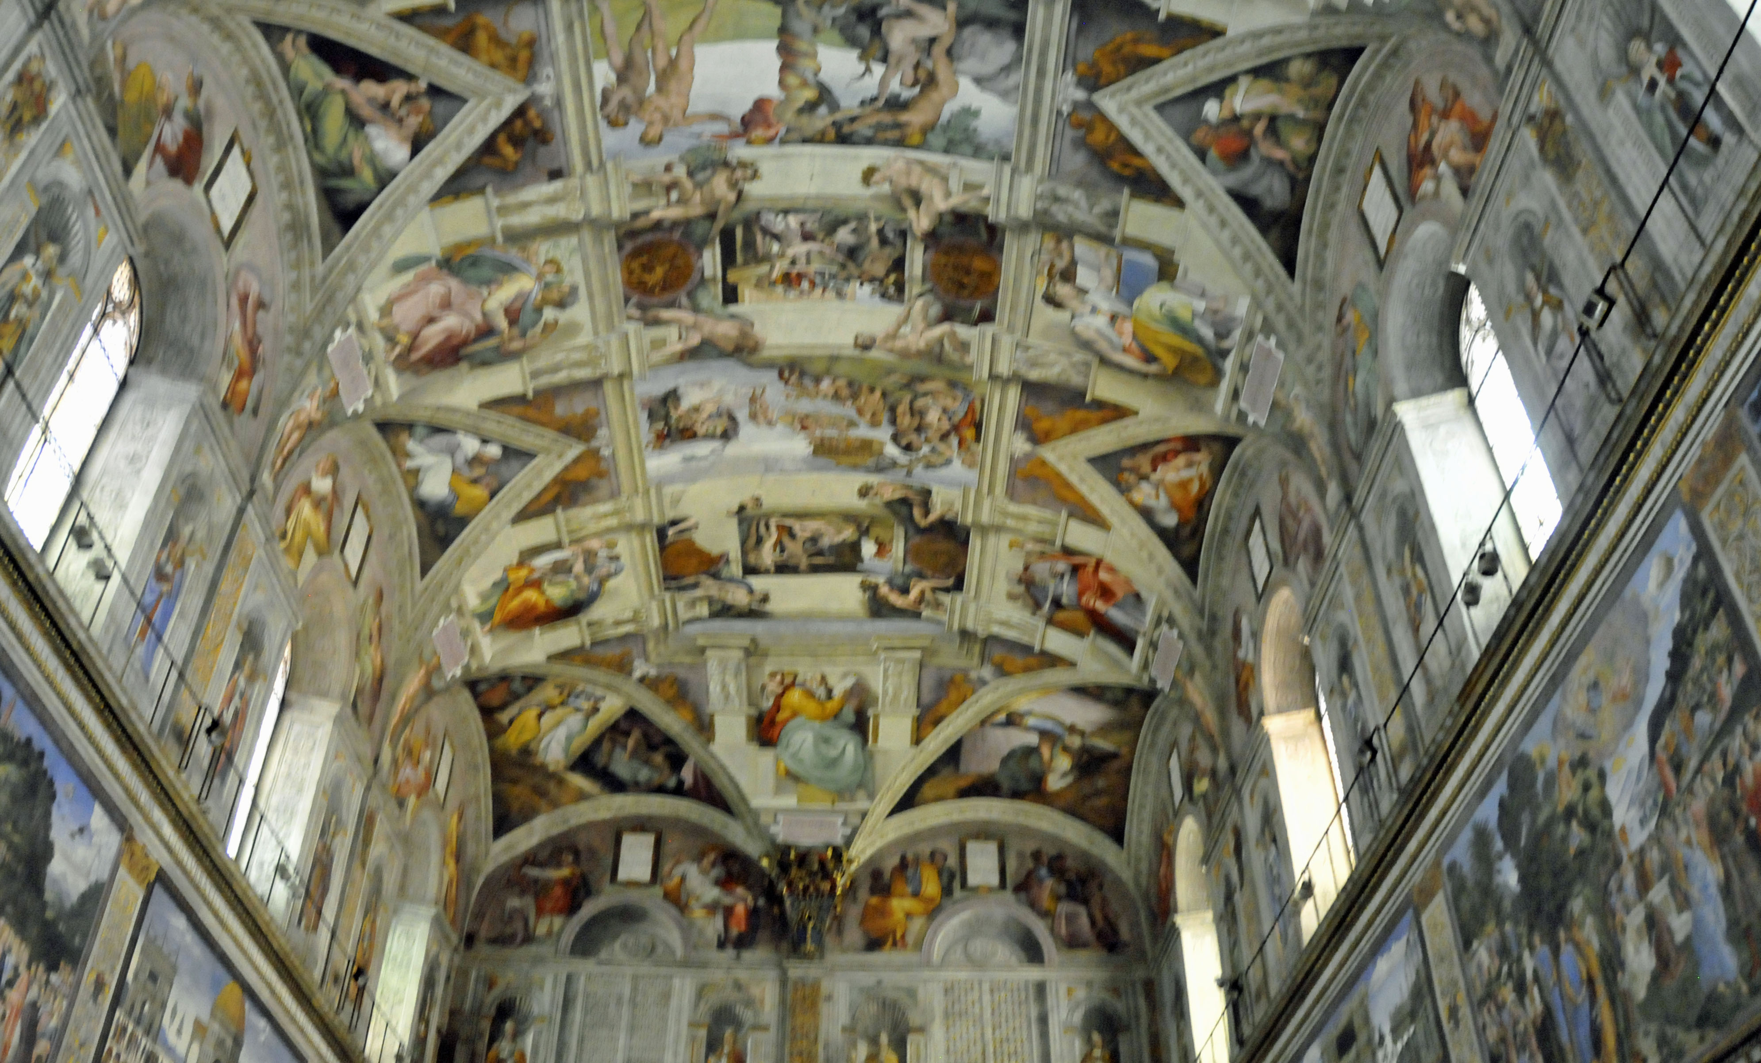

Slide 3
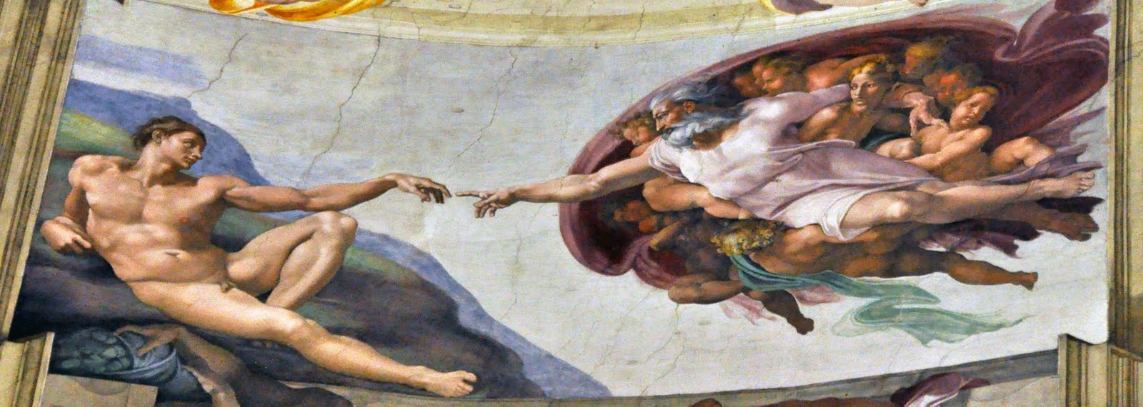

Slide 4
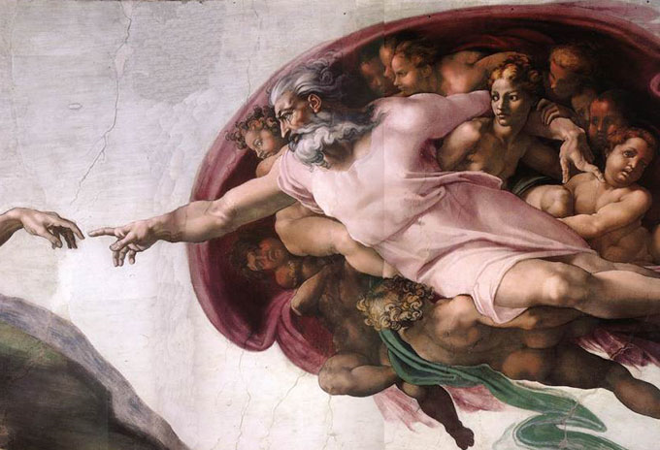

Slide 5
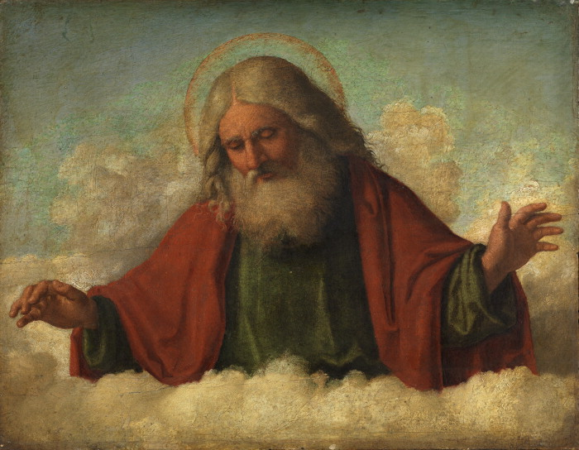
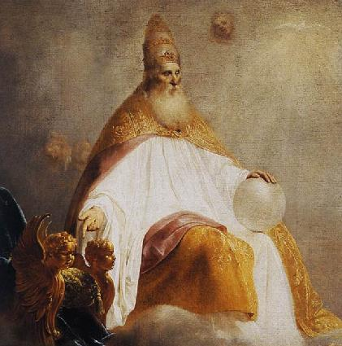
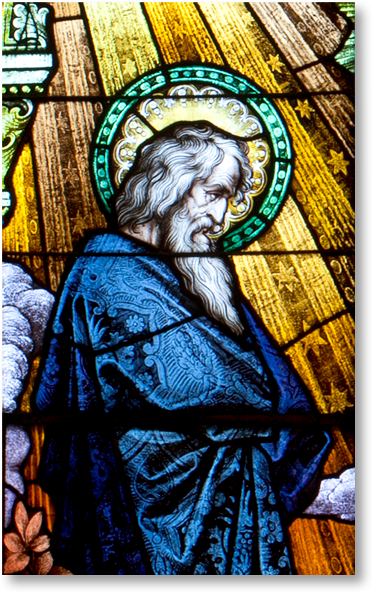
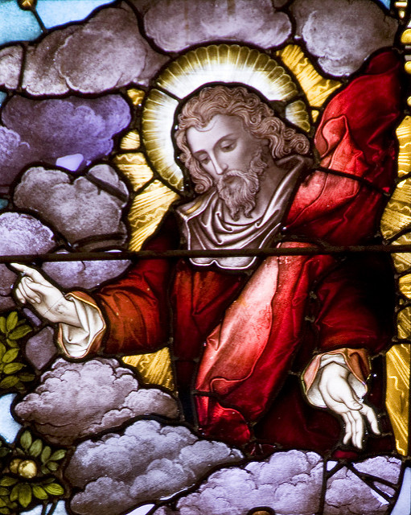
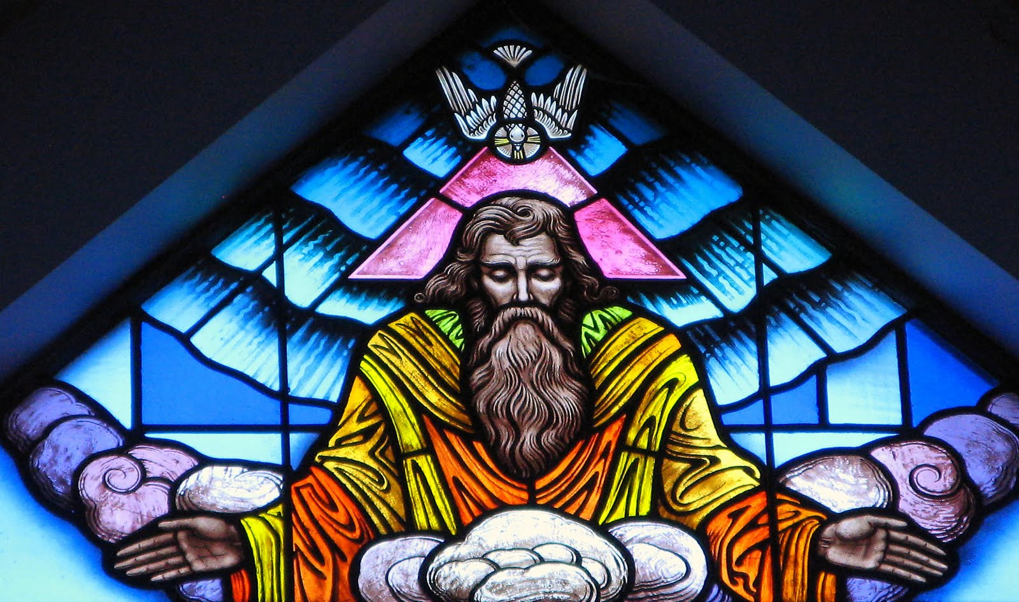
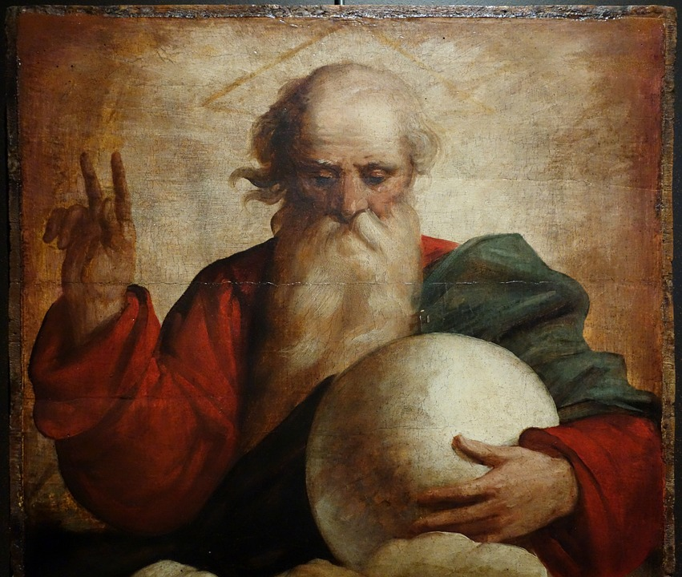
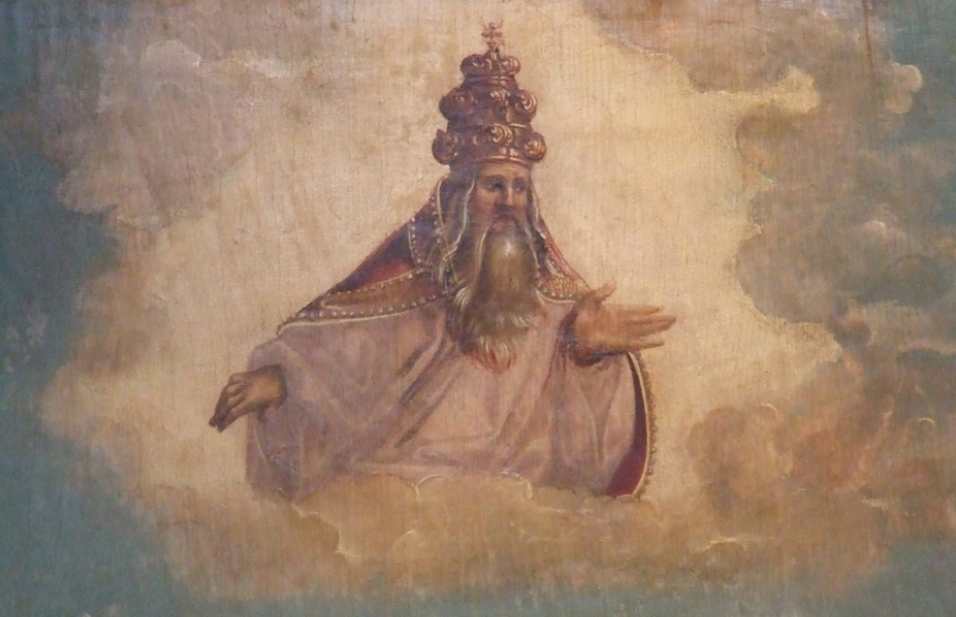
“God created mankind in his image, so we return the favor and make him into our own image.”

Slide 6
POSITIVISM…
A philosophical system that holds that every rationally justifiable assertion can be scientifically verified or is capable of logical or mathematical proof, it rejects metaphysis and theism

Slide 7
SEEING THE INVISIBLE
HIS WORKS
ROM 1; PSA 19
HIS WORD
JOHN 1, 14; 1 JOHN 1

Slide 8
SEEING THE INVISIBLE
FAITH
HEB 11
HOPE
ROM 8
LOVE
1 PET 1

