Slide 3
INTELLECTUALISM
Know it all’s

Slide 4
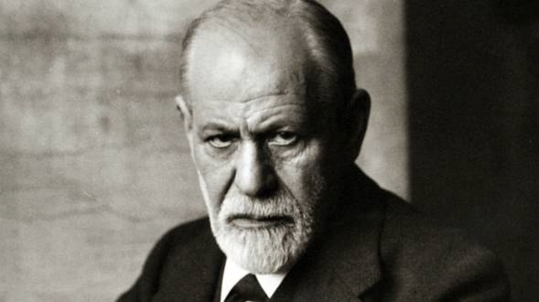
“An illusion, based on the infantile need for a powerful father figure”
“Religion was necessary to help us restrain violent impulses earlier in the
development of civilization,
can now be set aside in favor
of reason and science”

Slide 5
INTELLECTUALISM
Know it all’s
LEGALISM
Do it all’s
MYSTICISM
See it all’s
DOGMATISM
Fix it all’s

Slide 6
POISONOUS
PERSUASIVE
PERSONAL

Slide 7
INTELLECTUALISM
Denies sufficiency of Christ
LEGALISM
Follows shadows not substance
MYSTICISM
Based on personal revelations
DOGMATISM
Doesn’t go far enough

