Slide 2
LOST IN THE CREDITS
SONS OF KORAH
PSALMS
EXTRAORDINARY LESSONS FROM
ORDINARY PEOPLE

Slide 3
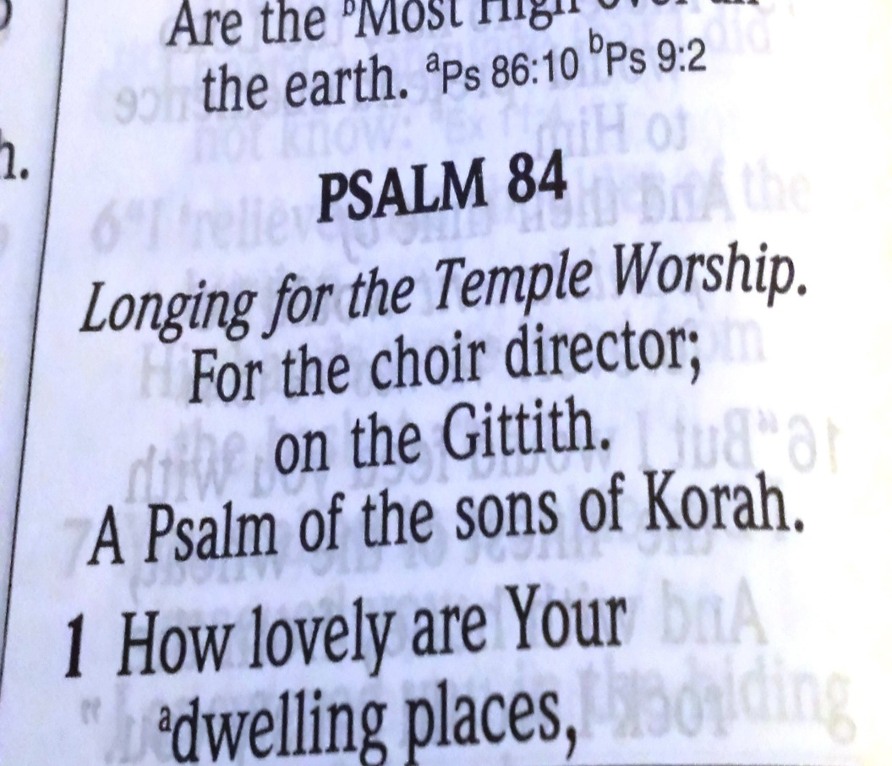
SONS OF KORAH
ACCOUNTABILITY
ACCEPTANCE
ACCOMPLISHMENT

