Slide 2
LOST IN THE CREDITS
TAMAR
GENESIS 38
EXTRAORDINARY LESSONS FROM
ORDINARY PEOPLE

Slide 3
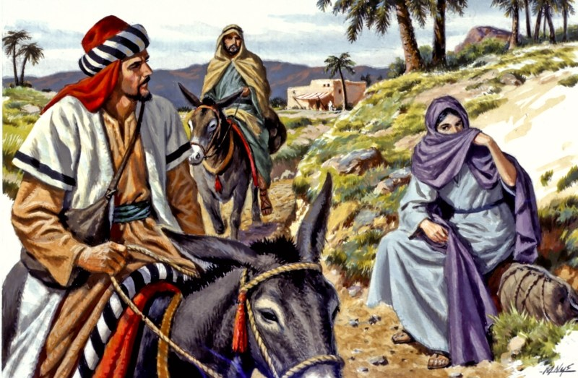
TAMAR
MAGNIFIES THE FAITH OF JOSEPH
MAGNIFIES THE GRACE OF GOD
MAGNIFIES THE WORDS OF CHRIST

