Slide 2
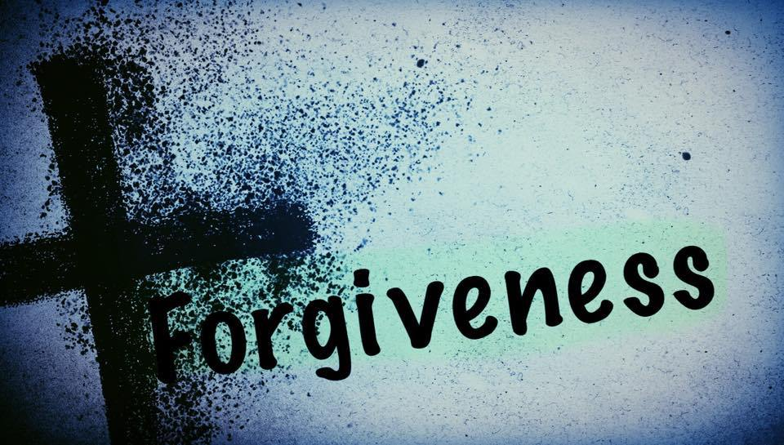

Slide 3
COMPLETE
CONTINUALLY
CONDITIONAL
CAN’T WAIT

Slide 4
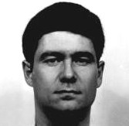
"I do not have a choice, I had to. Nothing is going to bring my son back. I can hate Ricky Blackmon and be miserable and bitter the rest of my life, or I can accept the apology and learn to be happy with that and go on, and that is what I choose to do."

