Slide 2
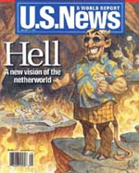
“With fire and brimstone out of fashion, modern thinking says the netherworld isn't so hot after all”

Slide 3
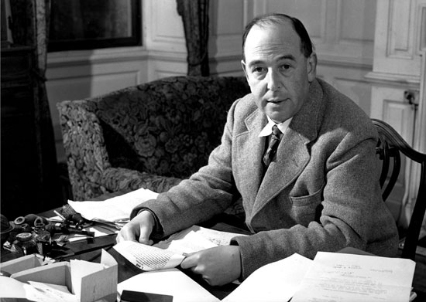
“There is no other doctrine which I would more willingly remove from Christianity than [hell], if it lay in my power. . . I would pay any price to be able to say truthfully: ‘All will be saved’

Slide 4
80 WORDS FROM HELL
ETERNAL TORMENT

Slide 5
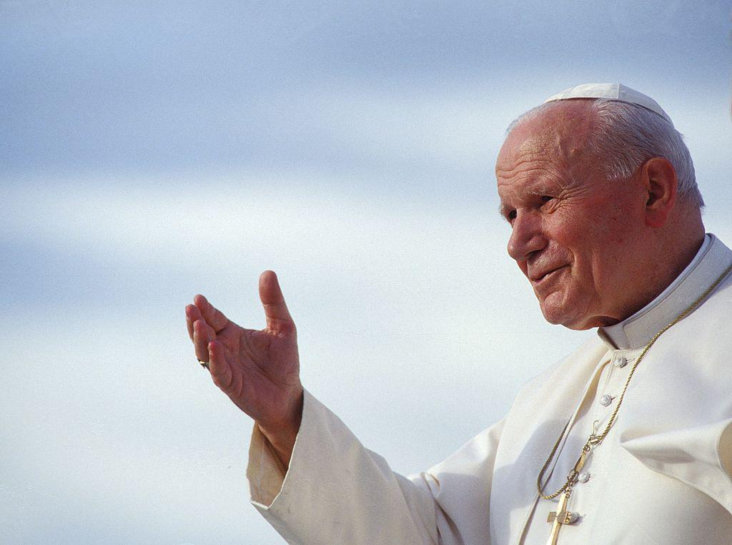
Hell is not a place, but a state of those who freely separated themselves from God All the language about hell is figurative There is no “pool of fire” no eternal torments

Slide 6
“When the first man, Adam, sinned, God told him that his punishment would simply be to pass out of existence: “Dust you are and to dust you will return.” (Gen 3.19) God would have been lying if he were actually sending Adam to a fiery hell. The idea that he would punish people n hellfire is contrary to the Bible’s teaching that “God is love.” 1 John 4.8; Jer 7.31 (Ask the Jehovah Witness, on line answers)

Slide 7
“How repugnant to every emotion of love and mercy, and even to our sense of justice, is the doctrine that the wicked dead are tormented with fire and brimstone in an eternally burning hell. . . . And how utterly revolting is the belief that as soon as the breath leaves the body the soul of the impenitent is consigned to the flames of hell!” (Ellen White, The Great Controversy, pp. 469, 470, 477, 478, 483).

Slide 8
80 WORDS FROM HELL
ETERNAL TORMENT
CAN’T LEAVE
CAN AVOID

