Slide 2
LOST IN THE CREDITS
ASA
1 KINGS 15; 2 CHR 14-16
EXTRAORDINARY LESSONS FROM
ORDINARY PEOPLE

Slide 3
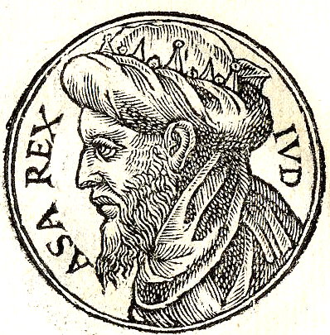
ASA

Slide 4
REFORMS OF ASA
Removed Idolatry
Restocked the Temple
Routed His Enemies
Renewed the Covenant

Slide 5
MISTAKES OF ASA
Military- Tribute
Moral- Temper
Medical- Treatment

Slide 6
LESSONS FROM ASA
Self-reliance
Pride
Despising Discipline

