Slide 2
LOST IN THE CREDITS
UNNAMED PROPHET
1 KINGS 13
EXTRAORDINARY LESSONS FROM
ORDINARY PEOPLE

Slide 3
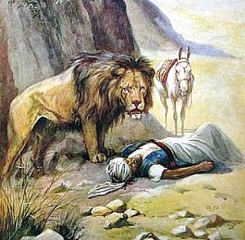
UNNAMED PROPHET
Satan never gives up
Be careful who you believe
Sin should make us angry

