Slide 1
BAPTISM
Why is there so much confusion about what this word means?
Matthew 12:49 – Leviticus 10:1-3

Slide 2
BAPTIZED
Matt 3:5-6
Matt 3:11
Matt 3:16
Matt 28:19
Mark 1:4
Mark 1:8
Mark 1:9
Mark 16:15-16
Luke 3:3
Luke 3:7
Luke 3:12
Luke 3:21
Luke 7:29,30
John 3:22,23
John 3:26
Acts 1:5
Acts 2:38
In the Jordan, confessing sins
Acts 2:41
Acts 8:12
Acts 8:13
Acts 8:36
Acts 8:38
Acts 8:39
Acts 10:47-48
Acts 11:16
Acts 16:15
Acts 16:31-33
Acts 18:8
Acts 19:4,5
Acts 22:16
Romans 6:3-11
f
Gladly receive word - baptized
Water unto repentance
Preached – men & women baptized
Came up from the water
Believed and was baptized
All nations, Authority Heaven
Saw water – asked to be baptized
Repentance Remission of Sins
Both went down into the water
Water
Jordan – Came up from water
Both came up from the water
Believe + Baptism = Saved
Can’t prevent water baptism
Repentance for Remission Sin
John baptized with water
Multitudes baptized
Lydia + household baptized
Tax collectors baptized
Heard about Jesus - baptized
Jesus baptized
Baptized by John
Crispus/Others believed - baptized
Jordan – “much water there”
Baptized in name of Jesus
Come to Jesus for baptism
Don’t delay – Wash away sins
Baptism water – Holy Spirit
Repent – baptized – Sins Forgiven

Slide 3
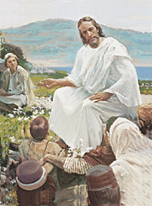
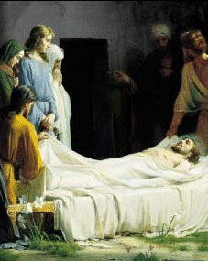
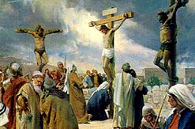
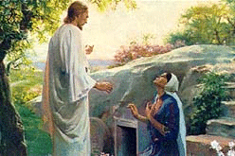
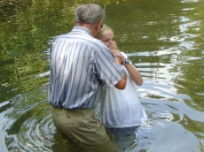
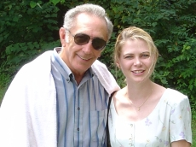
Rom 6:1-11
4 Therefore we have been buried with Him through baptism into death, so that as Christ was raised from the dead through the glory of the Father, so we too might walk in newness of life. 5 For if we have become united with Him in the likeness of His death, certainly we shall also be in the likeness of His resurrection, 6 knowing this, that our old self was crucified with Him, in order that our body of sin might be done away with, so that we would no longer be slaves to sin; 7 for he who has died is freed from sin.

Slide 4
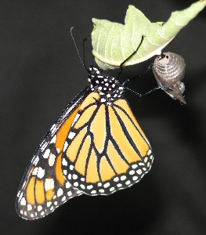
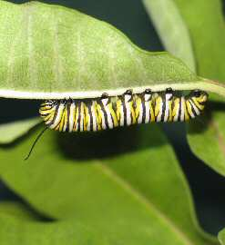
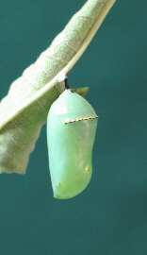
Rom 6:1-11
4 Therefore we have been buried with Him through baptism into death, so that as Christ was raised from the dead through the glory of the Father, so we too might walk in newness of life. 5 For if we have become united with Him in the likeness of His death, certainly we shall also be in the likeness of His resurrection, 6 knowing this, that our old self was crucified with Him, in order that our body of sin might be done away with, so that we would no longer be slaves to sin; 7 for he who has died is freed from sin.
NEW LIFE
We Live
We are Raised “like” Christ to a NEW LIFE
We Sin and separate ourselves from GOD!
We Repent
Die to our Sins
We are Buried “like” Christ

Slide 5
1 Cor 1:13
1 Cor 1:15
1Cor 1:16
1 Cor 12:13
Gal 3:27
Eph 4:5
Col 2:12
1 Pet 3:21
Not baptized in Paul’s name
Not baptized in Paul’s name
Paul baptized some
Baptized by one spirit one body
Baptized into Christ
One baptism same as One Christ
Buried with him in Baptism
Baptism now saves you
BAPTIZED

Slide 6
Rom 6:1-11
4 Therefore we have been buried with Him through baptism into death, so that as Christ was raised from the dead through the glory of the Father, so we too might walk in newness of life. 5 For if we have become united with Him in the likeness of His death, certainly we shall also be in the likeness of His resurrection, 6 knowing this, that our old self was crucified with Him, in order that our body of sin might be done away with, so that we would no longer be slaves to sin; 7 for he who has died is freed from sin.
NEW LIFE
We Live
We are Raised “like” Christ to a NEW LIFE
We Sin and separate ourselves from GOD!
We Repent
Die to our Sins
We are Buried “like” Christ

