Slide 2
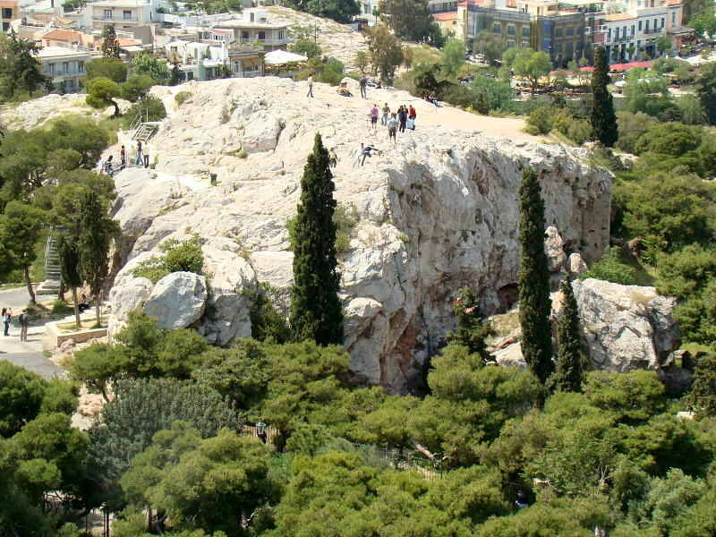

Slide 3
MESSAGE FROM MARS HILL
RACE

Slide 4
“You've got to be taught To hate and fear, You've got to be taught From year to year, It's got to be drummed In your dear little ear You've got to be carefully taught.
You've got to be taught to be afraid, Of people whose eyes are oddly made, And people whose skin is a different shade, You've got to be carefully taught.
You've got to be taught before it's too late, Before you are six or seven or eight, To hate all the people your relatives hate, You've got to be carefully taught!”

Slide 5
MESSAGE FROM MARS HILL
RACE
REAL ESTATE
RELIGION

