Slide 1
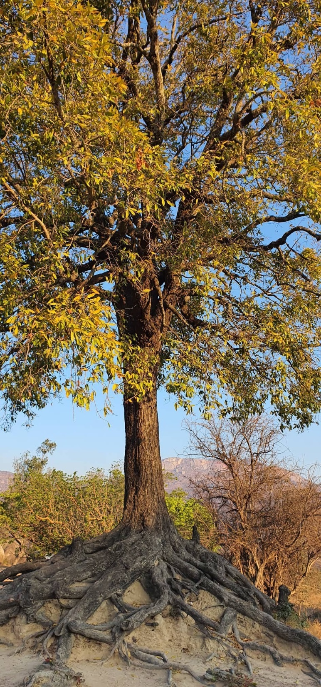

Slide 2
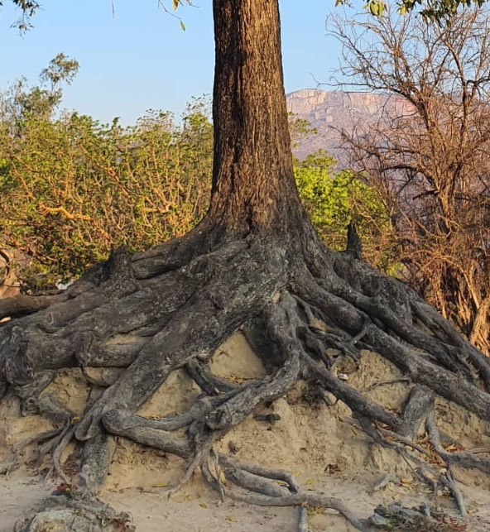
This Old Tree
by Ross Rosenberg
The old oak tree stands tall and crooked. Its cracked, coarse and weathered surface reflects the assault of the seasons.
Rain, heat and snow of seasons past grated at its surface with diamond sharp teeth, digging in, leaving permanent marks.

Slide 3
In defiance, the tree stretches, grows and moves skyward.
Its roots reach around rocky obstacles, firmly anchoring itself to the earth, exerting strength and desire, forcing its viability to grow into yet another season.
With roots dug deeply into uninviting rocky and inhospitable soil, the tree forcefully establishes its home.

Slide 4
And the tree proclaims:
“I am a tree I am from the earth. Neither floods, storms, nor drought will tear me away from where my roots cling.
I remain where I belong The earth is my home.”

Slide 5
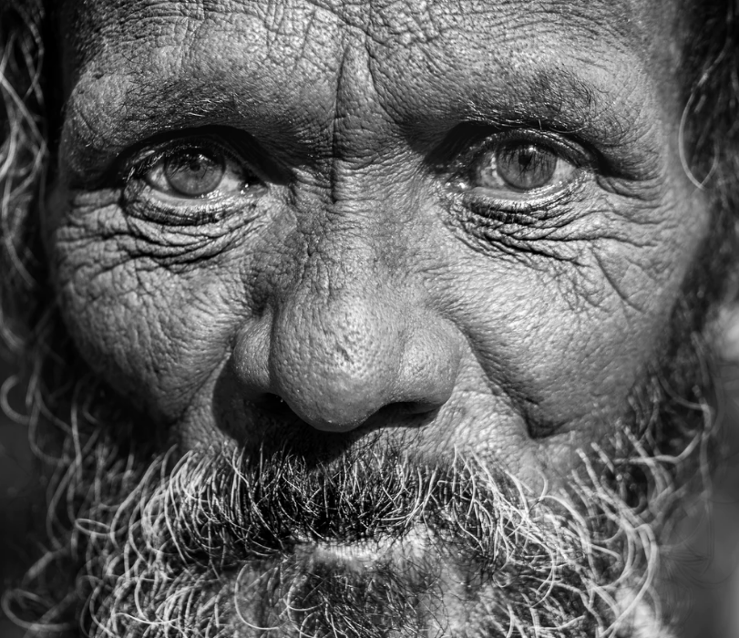
And the man proclaims:
“I am a man I am from God. Neither the cares of this world, the trials of life, nor doubt will tear me away from where my roots cling.
I remain where I belong and heaven is my home.”

