Slide 2
LOST IN THE CREDITS
hagar
GENESIS 16
EXTRAORDINARY LESSONS FROM
ORDINARY PEOPLE

Slide 3
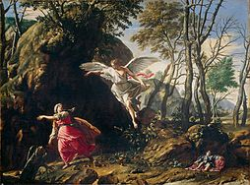
ABRAHAM
He wasn’t getting any younger
It was a common practice
He wanted to keep Sarai happy
God wasn’t moving fast enough
HIS FAITH WAS WEAK

Slide 4
GALATIANS 3-4
Conversion
Law
Promise
Personal
Allegorical
Two sons
Two births
Two women

Slide 5
