Slide 2
LOST IN THE CREDITS
LUKE
Col 4.14
EXTRAORDINARY LESSONS FROM
ORDINARY PEOPLE

Slide 3
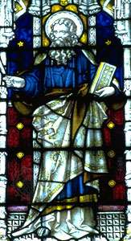
LUKE
“Luke the beloved physician”
Physician
Beloved

