Slide 2
LOST IN THE CREDITS
RIZPAH
2 SAM 21
EXTRAORDINARY LESSONS FROM
ORDINARY PEOPLE

Slide 3
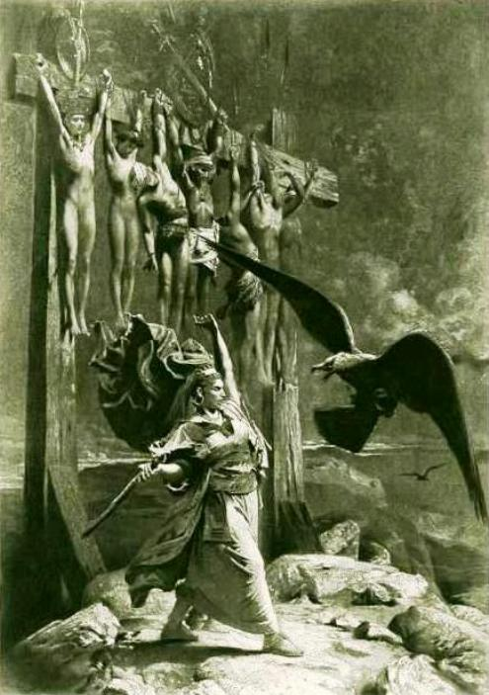
RIZPAH
HER LOVE
HER DEVOTION
HER FAITH

