Slide 2
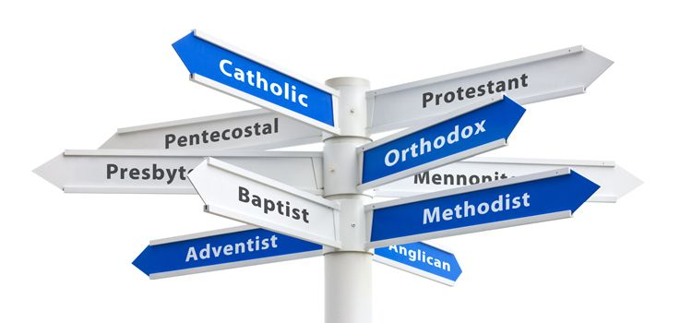
DENOMINATION DEFINED
“a religious organization uniting local congregations in a single legal and administrative body”

Slide 3
THREE NEGLECTED LAWS
Law of Completeness
Law of Harmony
Law of Instruction
Direct Commands
Approved Examples
Necessary Inferences
Silence of Scripture

Slide 4
THREE NEGLECTED LAWS
Law of Completeness
Law of Harmony
Law of Instruction
Direct Commands- James v14
Approved Examples- Paul v12
Necessary Inferences- Peter v9
Silence of Scripture- Letter v28

