Slide 1
Issues Facing Elders
Lesson Twenty One

Slide 2
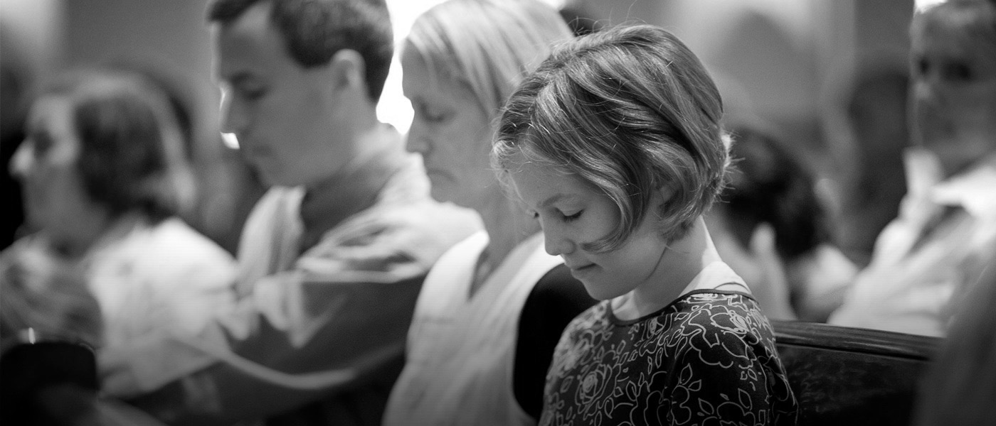
prayer

Slide 3
Issues Facing Elders
Lesson Twenty One

Slide 4
Issues Facing Elders
Elders must protect the truth
Elders must protect their reputation
Elders must protect their families

Slide 5
Elders Must Protect Their Families
1 Timothy 3:11
Likewise, their wives must be reverent, not slanderers, temperate, faithful in all things.
Biblical evidence suggests that Godly submission should be a product of the character of elders and deacons

Slide 6
Elders Must Protect Their Families
It is not enough that elders have a Godly family (up until this point)
A strong Christian family network must be maintained:
^{Ephesians 6:1-4}
Children, obey your parents in the Lord, for this is right. 2 “Honor your father and mother,” which is the first commandment with promise: 3 “that it may be well with you and you may live long on the earth.” 4 And you, fathers, do not provoke your children to wrath, but bring them up in the training and admonition of the Lord.

Slide 7
Elders Must Protect Their Families
So how do you MAKE your children and wife submit?
How does God get us to obey?
Not with coercion!

Slide 8
Elders Must Protect Their Families
1 John 5:2-4
2 By this we know that we love the children of God, when we love God and keep His commandments. 3 For this is the love of God, that we keep His commandments. And His commandments are not burdensome. 4 For whatever is born of God overcomes the world. And this is the victory that has overcome the world—our faith.

Slide 9
Elders Must Protect Their Families
Matthew 20:25-28
25 But Jesus called them to Himself and said, “You know that the rulers of the Gentiles lord it over them, and those who are great exercise authority over them. 26 Yet it shall not be so among you; but whoever desires to become great among you, let him be your servant. 27 And whoever desires to be first among you, let him be your slave— 28 just as the Son of Man did not come to be served, but to serve, and to give His life a ransom for many.”

Slide 10
Elders must be able to manage relationships at home because they will be required to manage relationships in the church
Acts 15:22
22 Then it pleased the apostles and elders, with the whole church, to send chosen men of their own company to Antioch with Paul and Barnabas, namely, Judas who was also named Barsabas, and Silas, leading men among the brethren.

Slide 11
Elders Must Protect Their Families
1 Corinthians 1:10
10 Now I plead with you, brethren, by the name of our Lord Jesus Christ, that you all speak the same thing, and that there be no divisions among you, but that you be perfectly joined together in the same mind and in the same judgment.

Slide 12
Issues Facing Elders
Elders must protect the truth
Elders must protect their reputation
Elders must protect their families
Elders must protect efficiency

Slide 13
Elders Must Protect Efficiency
Does a local church need to be run like a company?
We need to avoid appointing “board members” as elders
But growth of a church requires principles used in business

Slide 14
Elders Must Protect Efficiency
Romans 12:4-5
5 so we, being many, are one body in Christ, and individually members of one another. 6 Having then gifts differing according to the grace that is given to us, let us use them: if prophecy, let us prophesy in proportion to our faith; 7 or ministry, let us use it in our ministering; he who teaches, in teaching; 8 he who exhorts, in exhortation; he who gives, with liberality; he who leads, with diligence; he who shows mercy, with cheerfulness.

Slide 15
Issues Facing Elders
Elders must protect the truth
Elders must protect their reputation
Elders must protect their families
Elders must protect efficiency
Elders must protect the weak

Slide 16
Elders Must Protect the Weak
Matthew 18:10-14
10 “Take heed that you do not despise one of these little ones, for I say to you that in heaven their angels always see the face of My Father who is in heaven. 11 For the Son of Man has come to save that which was lost.
12 “What do you think? If a man has a hundred sheep, and one of them goes astray, does he not leave the ninety-nine and go to the mountains to seek the one that is straying? 13 And if he should find it, assuredly, I say to you, he rejoices more over that sheep than over the ninety-nine that did not go astray. 14 Even so it is not the will of your Father who is in heaven that one of these little ones should perish.

Slide 17
Elders Must Protect Efficiency
What is a bottleneck?
The church was designed by God to help the weak, not eliminate them.
We do not “thin the herd here”

Slide 18
Elders Must Protect Efficiency
What is a steward?
Titus 1:7
7 For a bishop must be blameless, as a steward of God, not self-willed, not quick-tempered, not given to wine, not violent, not greedy for money,

Slide 19
Is it easier for us to avoid drama?
God commands us to address drama…
Matthew 18:15
15 “Moreover if your brother sins against you, go and tell him his fault between you and him alone. If he hears you, you have gained your brother.

