Slide 2
LOST IN THE CREDITS
SOSTHENES
ACTS 18; 1 COR 1
EXTRAORDINARY LESSONS FROM
ORDINARY PEOPLE

Slide 3
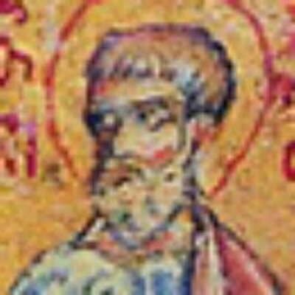
SOSTHENES
No such thing as going to far
Christ can reconcile former enemies
God can use the most unlikely people to serve Him

